Slide 1
Chapter 5 – Intro Pandas
2025-2026

Slide 2
Overview
Introduction
Data structures in pandas: Series and DataFrame
Extracting and assigning data
Reading/writing data (CSV, JSON and SQLite)
Basic DataFrame operations
Missing values
Conditional selections, sorting, grouping & counting
Cleaning a dataset (using an example)

Slide 3

The most popular Python library for data analysis
Through pandas, you get acquainted with your data
Pandas helps you
calculate statistics and answer questions about the data, like
What's the average, median, max, or min of each column?
Does column A correlate to column B?
What does the distribution of data in column C look like?
clean the data by doing things like removing missing values and filtering rows or columns
visualize the data with help from Matplotlib (plot bars, lines, histograms, bubbles, …)
store the cleaned, transformed data back into a CSV, other file or database
pandas is derived from the term “panel data” which are data sets that include observations over multiple time periods for the same individuals [Wikipedia]

Slide 4
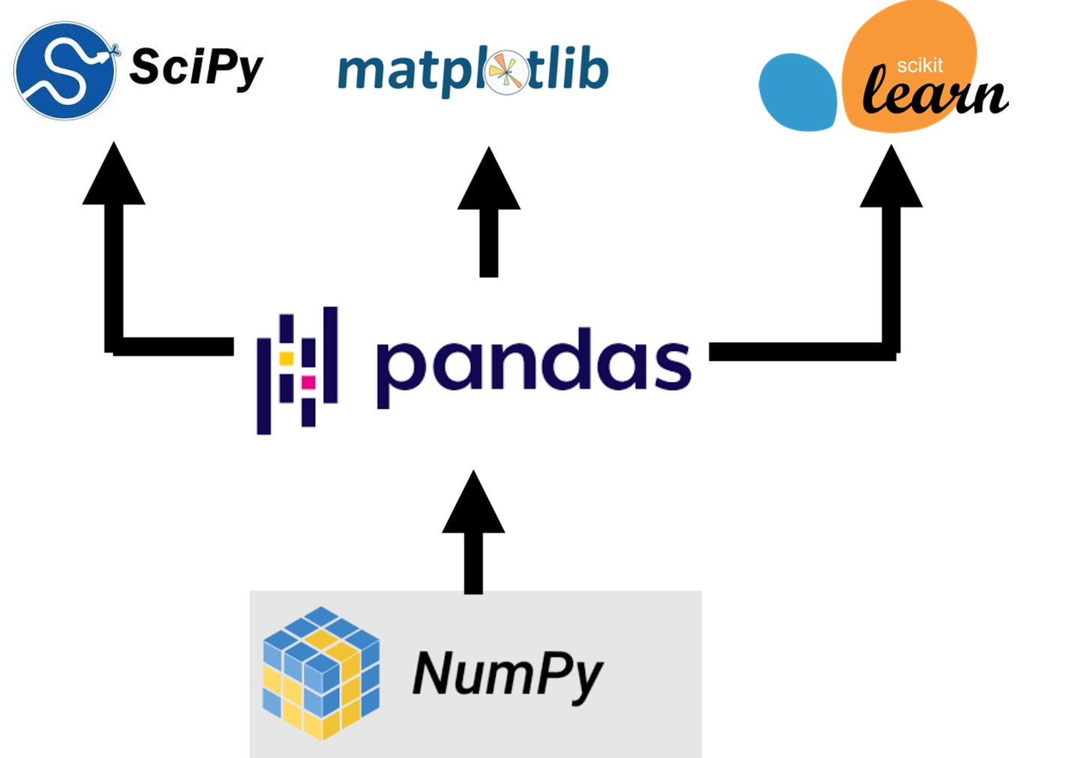
The pandas library is a central component of the data science toolkit, but it is used in conjunction with other libraries.
Pandas is built on top of the NumPy package, meaning a lot of the structure of NumPy is used or replicated in pandas.
Data in pandas is often used to feed statistical analysis in SciPy, plotting functions in Matplotlib and SeaBorn, and machine learning algorithms in Scikit-learn.

Slide 5
Install and import pandas
Run the install command in a terminal window:
pip install pandas
In Jupyter you must use a preceding ! to force the code cell to be executed in a terminal window: !pip install pandas
To import pandas we usually import it with a shorter name since it's used so much: import pandas as pd

Slide 6
About dirty data

Slide 7
Same data, different formats
country year cases population
<chr> <int> <int> <int>
1 Afghanistan 1999 745 19987071
2 Afghanistan 2000 2666 20595360
3 Brazil 1999 37737 172006362
4 Brazil 2000 80488 174504898
5 China 1999 212258 1272915272
6 China 2000 213766 1280428583
2
country year type count
<chr> <int> <chr> <int>
1 Afghanistan 1999 cases 745
2 Afghanistan 1999 population 19987071
3 Afghanistan 2000 cases 2666
4 Afghanistan 2000 population 20595360
5 Brazil 1999 cases 37737
6 Brazil 1999 population 172006362
7 Brazil 2000 cases 80488
8 Brazil 2000 population 174504898
9 China 1999 cases 212258
10 China 1999 population 1272915272
11 China 2000 cases 213766
12 China 2000 population 1280428583
1
3
country year rate
* <chr> <int> <chr>
1 Afghanistan 1999 745/19987071
2 Afghanistan 2000 2666/20595360
3 Brazil 1999 37737/172006362
4 Brazil 2000 80488/174504898
5 China 1999 212258/1272915272
6 China 2000 213766/1280428583
4
country `1999` `2000`
* <chr> <int> <int>
1 Afghanistan 19987071 20595360
2 Brazil 172006362 174504898
3 China 1272915272 1280428583
country `1999` `2000`
* <chr> <int> <int>
1 Afghanistan 745 2666
2 Brazil 37737 80488
3 China 212258 213766

Slide 8
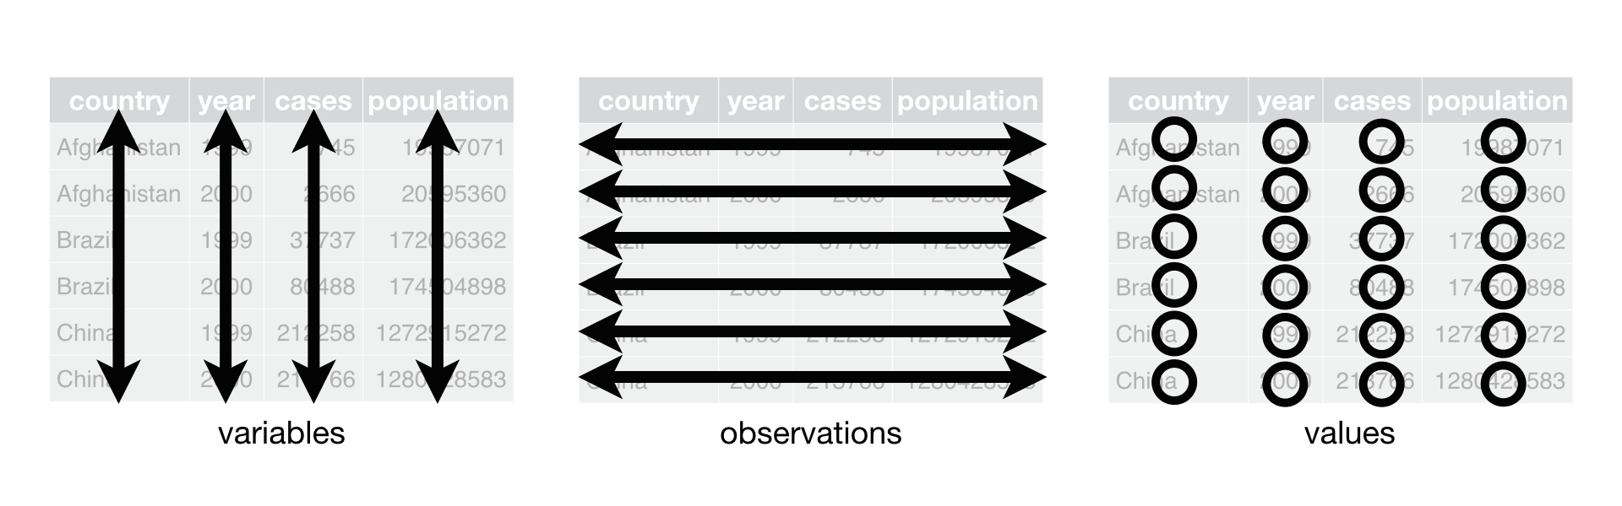
3 rules for data files
Each variable must have its own column.
Each observation must have its own row.
Each value must have its own cell.

Slide 9
Does each variable have its own column?
country year cases population
<chr> <int> <int> <int>
1 Afghanistan 1999 745 19987071
2 Afghanistan 2000 2666 20595360
3 Brazil 1999 37737 172006362
4 Brazil 2000 80488 174504898
5 China 1999 212258 1272915272
6 China 2000 213766 1280428583
2
country year type count
<chr> <int> <chr> <int>
1 Afghanistan 1999 cases 745
2 Afghanistan 1999 population 19987071
3 Afghanistan 2000 cases 2666
4 Afghanistan 2000 population 20595360
5 Brazil 1999 cases 37737
6 Brazil 1999 population 172006362
7 Brazil 2000 cases 80488
8 Brazil 2000 population 174504898
9 China 1999 cases 212258
10 China 1999 population 1272915272
11 China 2000 cases 213766
12 China 2000 population 1280428583
1
3
country year rate
* <chr> <int> <chr>
1 Afghanistan 1999 745/19987071
2 Afghanistan 2000 2666/20595360
3 Brazil 1999 37737/172006362
4 Brazil 2000 80488/174504898
5 China 1999 212258/1272915272
6 China 2000 213766/1280428583
4
country `1999` `2000`
* <chr> <int> <int>
1 Afghanistan 19987071 20595360
2 Brazil 172006362 174504898
3 China 1272915272 1280428583
country `1999` `2000`
* <chr> <int> <int>
1 Afghanistan 745 2666
2 Brazil 37737 80488
3 China 212258 213766

Slide 10
Each variable must have its own column
country year cases population
<chr> <int> <int> <int>
1 Afghanistan 1999 745 19987071
2 Afghanistan 2000 2666 20595360
3 Brazil 1999 37737 172006362
4 Brazil 2000 80488 174504898
5 China 1999 212258 1272915272
6 China 2000 213766 1280428583
country year type count
<chr> <int> <chr> <int>
1 Afghanistan 1999 cases 745
2 Afghanistan 1999 population 19987071
3 Afghanistan 2000 cases 2666
4 Afghanistan 2000 population 20595360
5 Brazil 1999 cases 37737
6 Brazil 1999 population 172006362
7 Brazil 2000 cases 80488
8 Brazil 2000 population 174504898
9 China 1999 cases 212258
10 China 1999 population 1272915272
11 China 2000 cases 213766
12 China 2000 population 1280428583
type and count are no true variables (= characteristics of the observation object)
country year rate
* <chr> <int> <chr>
1 Afghanistan 1999 745/19987071
2 Afghanistan 2000 2666/20595360
3 Brazil 1999 37737/172006362
4 Brazil 2000 80488/174504898
5 China 1999 212258/1272915272
6 China 2000 213766/1280428583
1999 and 2000 are not variables, they are values!
country `1999` `2000`
* <chr> <int> <int>
1 Afghanistan 19987071 20595360
2 Brazil 172006362 174504898
3 China 1272915272 1280428583
country `1999` `2000`
* <chr> <int> <int>
1 Afghanistan 745 2666
2 Brazil 37737 80488
3 China 212258 213766
One column contains two variables

Slide 11
Does each observation have its own row?
country year cases population
<chr> <int> <int> <int>
1 Afghanistan 1999 745 19987071
2 Afghanistan 2000 2666 20595360
3 Brazil 1999 37737 172006362
4 Brazil 2000 80488 174504898
5 China 1999 212258 1272915272
6 China 2000 213766 1280428583
2
country year type count
<chr> <int> <chr> <int>
1 Afghanistan 1999 cases 745
2 Afghanistan 1999 population 19987071
3 Afghanistan 2000 cases 2666
4 Afghanistan 2000 population 20595360
5 Brazil 1999 cases 37737
6 Brazil 1999 population 172006362
7 Brazil 2000 cases 80488
8 Brazil 2000 population 174504898
9 China 1999 cases 212258
10 China 1999 population 1272915272
11 China 2000 cases 213766
12 China 2000 population 1280428583
1
3
country year rate
* <chr> <int> <chr>
1 Afghanistan 1999 745/19987071
2 Afghanistan 2000 2666/20595360
3 Brazil 1999 37737/172006362
4 Brazil 2000 80488/174504898
5 China 1999 212258/1272915272
6 China 2000 213766/1280428583
4
country `1999` `2000`
* <chr> <int> <int>
1 Afghanistan 19987071 20595360
2 Brazil 172006362 174504898
3 China 1272915272 1280428583
country `1999` `2000`
* <chr> <int> <int>
1 Afghanistan 745 2666
2 Brazil 37737 80488
3 China 212258 213766

Slide 12
Each observation must have its own row
country year type count
<chr> <int> <chr> <int>
1 Afghanistan 1999 cases 745
2 Afghanistan 1999 population 19987071
3 Afghanistan 2000 cases 2666
4 Afghanistan 2000 population 20595360
5 Brazil 1999 cases 37737
6 Brazil 1999 population 172006362
7 Brazil 2000 cases 80488
8 Brazil 2000 population 174504898
9 China 1999 cases 212258
10 China 1999 population 1272915272
11 China 2000 cases 213766
12 China 2000 population 1280428583
country year cases population
<chr> <int> <int> <int>
1 Afghanistan 1999 745 19987071
2 Afghanistan 2000 2666 20595360
3 Brazil 1999 37737 172006362
4 Brazil 2000 80488 174504898
5 China 1999 212258 1272915272
6 China 2000 213766 1280428583
2 rows per observation
country year rate
* <chr> <int> <chr>
1 Afghanistan 1999 745/19987071
2 Afghanistan 2000 2666/20595360
3 Brazil 1999 37737/172006362
4 Brazil 2000 80488/174504898
5 China 1999 212258/1272915272
6 China 2000 213766/1280428583
Observations spread across two tables
country `1999` `2000`
* <chr> <int> <int>
1 Afghanistan 19987071 20595360
2 Brazil 172006362 174504898
3 China 1272915272 1280428583
country `1999` `2000`
* <chr> <int> <int>
1 Afghanistan 745 2666
2 Brazil 37737 80488
3 China 212258 213766

Slide 13
Does each value have its own cell?
country year cases population
<chr> <int> <int> <int>
1 Afghanistan 1999 745 19987071
2 Afghanistan 2000 2666 20595360
3 Brazil 1999 37737 172006362
4 Brazil 2000 80488 174504898
5 China 1999 212258 1272915272
6 China 2000 213766 1280428583
2
country year type count
<chr> <int> <chr> <int>
1 Afghanistan 1999 cases 745
2 Afghanistan 1999 population 19987071
3 Afghanistan 2000 cases 2666
4 Afghanistan 2000 population 20595360
5 Brazil 1999 cases 37737
6 Brazil 1999 population 172006362
7 Brazil 2000 cases 80488
8 Brazil 2000 population 174504898
9 China 1999 cases 212258
10 China 1999 population 1272915272
11 China 2000 cases 213766
12 China 2000 population 1280428583
1
3
country year rate
* <chr> <int> <chr>
1 Afghanistan 1999 745/19987071
2 Afghanistan 2000 2666/20595360
3 Brazil 1999 37737/172006362
4 Brazil 2000 80488/174504898
5 China 1999 212258/1272915272
6 China 2000 213766/1280428583
4
country `1999` `2000`
* <chr> <int> <int>
1 Afghanistan 19987071 20595360
2 Brazil 172006362 174504898
3 China 1272915272 1280428583
country `1999` `2000`
* <chr> <int> <int>
1 Afghanistan 745 2666
2 Brazil 37737 80488
3 China 212258 213766

Slide 14
Each value must have its own cell
country year cases population
<chr> <int> <int> <int>
1 Afghanistan 1999 745 19987071
2 Afghanistan 2000 2666 20595360
3 Brazil 1999 37737 172006362
4 Brazil 2000 80488 174504898
5 China 1999 212258 1272915272
6 China 2000 213766 1280428583
country year type count
<chr> <int> <chr> <int>
1 Afghanistan 1999 cases 745
2 Afghanistan 1999 population 19987071
3 Afghanistan 2000 cases 2666
4 Afghanistan 2000 population 20595360
5 Brazil 1999 cases 37737
6 Brazil 1999 population 172006362
7 Brazil 2000 cases 80488
8 Brazil 2000 population 174504898
9 China 1999 cases 212258
10 China 1999 population 1272915272
11 China 2000 cases 213766
12 China 2000 population 1280428583
country year rate
* <chr> <int> <chr>
1 Afghanistan 1999 745/19987071
2 Afghanistan 2000 2666/20595360
3 Brazil 1999 37737/172006362
4 Brazil 2000 80488/174504898
5 China 1999 212258/1272915272
6 China 2000 213766/1280428583
country `1999` `2000`
* <chr> <int> <int>
1 Afghanistan 19987071 20595360
2 Brazil 172006362 174504898
3 China 1272915272 1280428583
country `1999` `2000`
* <chr> <int> <int>
1 Afghanistan 745 2666
2 Brazil 37737 80488
3 China 212258 213766
One cell contains two values

Slide 15
Pandas – Data Structures

Slide 16
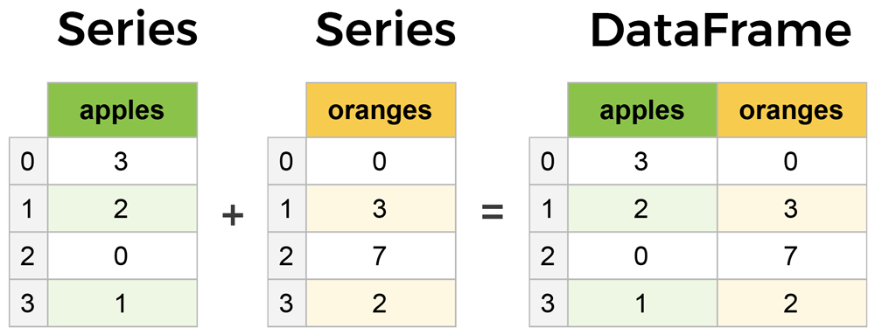
Core components of pandas: Series & DataFrame
A Series is essentially a column
A DataFrame is a multi-dimensional table made up of a collection of Series

Slide 17
Creating DataFrames from scratch
There are many ways to create a DataFrame from scratch, but a great option is to use a simple dictionary.
Let's say we have a fruit stand that sells apples and oranges. We want to have a column for each fruit and a row for each customer purchase. Organized as a dictionary this looks like:
The data dictionary counts 2 key-value pairs
Keys: apples + oranges Values: lists with the corresponding purchases
data = {
'apples': [3, 2, 0, 1],
'oranges': [0, 3, 7, 2]
}

Slide 18
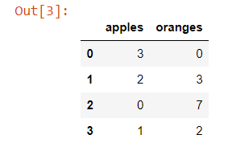
Creating DataFrames from scratch
Next the dictionary can be passed to the DataFrame constructor
Each (key, value) pair in the dictionary now corresponds to a column in the resulting DataFrame. The index of this DataFrame is generated on creation as the numbers 0-3.
purchases = pd.DataFrame(data) purchases

Slide 19
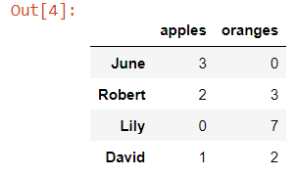

Creating DataFrames from scratch
Instead of the default numeric indexing, each row can get a custom index label: e.g. customer names
A datarow of a specific customer can then be located based on their name
purchases = pd.DataFrame(data, index=['June', 'Robert', 'Lily', ‘David'])
purchases
purchases = purchases.loc[ 'Lily']
To extract rows based on the index label, you use: .loc[‘label’]

Slide 20
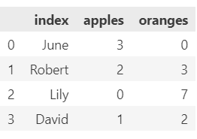
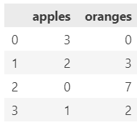
Reset index
You can always go back from the labeled indices (e.g. index=['June', 'Robert', 'Lily', ‘David’]) to the default numerical ones (e.g. 0-3) by using reset_index()
Use the drop parameter to avoid the old index being added as a column:
purchases =purchases.reset_index()
purchases =purchases.reset_index(drop = True)

Slide 21
Pandas – Extracting and assigning data

Slide 22
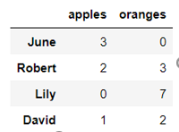

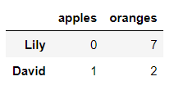
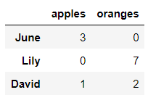
Extracting data
A datarow can also be extracted based on index number with iloc[index]
By specifying a list of indexes multiple rows are retrieved
purchases = purchases.iloc[2]
purchases = purchases.iloc[[2,3]]
purchases = purchases.iloc[[0,2,3]]

Slide 23
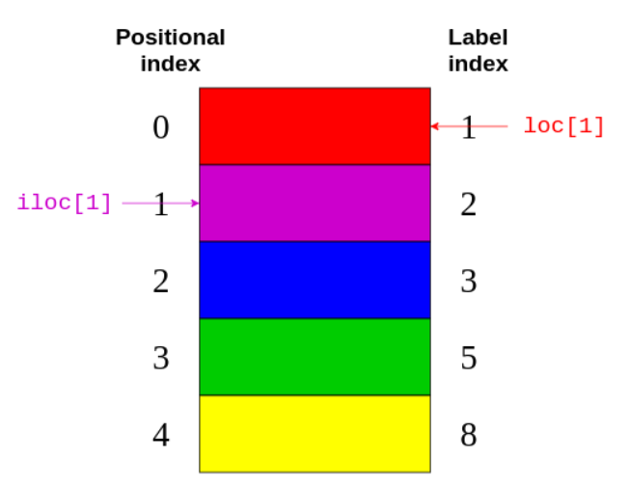
Extracting data
https://files.realpython.com/media/iloc_vs_loc_80_border20.d5280f475f4e.png

Slide 24
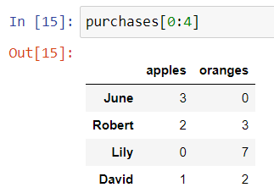
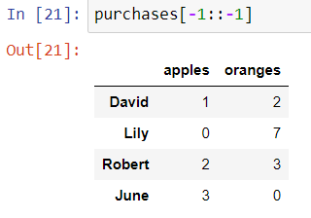
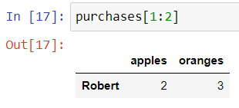
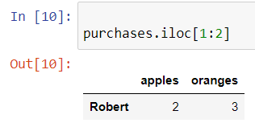
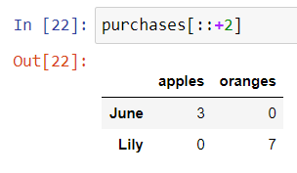
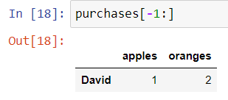
Extracting data
Extracting rows from a DataFrame can also be done by slicing

Slide 25
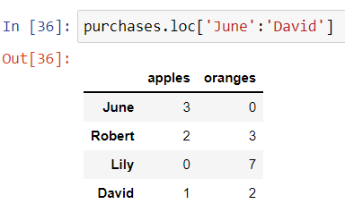
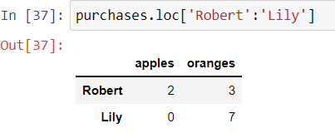
Extracting data
Slicing works with index labels
Note that if using labels (loc) the end-element is included in the result, which is not true in case of normal index-based slicing (iloc)

Slide 26

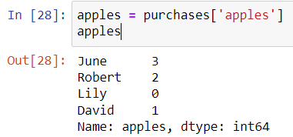
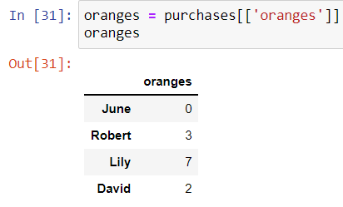
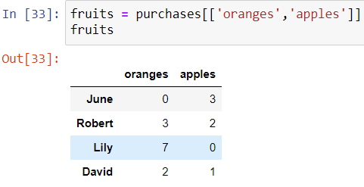


Extracting data
Extracting 1 column from a dataframe results in a Series
To extract columns as a DataFrame, you need to pass a list[] of column names
Note that purchases.apples will also work

Slide 27
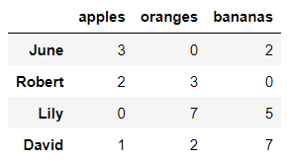
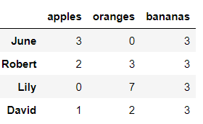
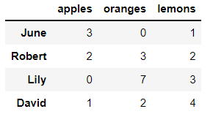
Assigning data
Going the other way, assigning data to a DataFrame is easy.
You can insert/update a column with either:
a constant value:
or an iterable of values:
purchases['bananas']=3
purchases['bananas’]=[2,0,5,7]
purchases['lemons'] = range(1,len(purchases)+1,+1)

Slide 28
Pandas – Read and write data

Slide 29
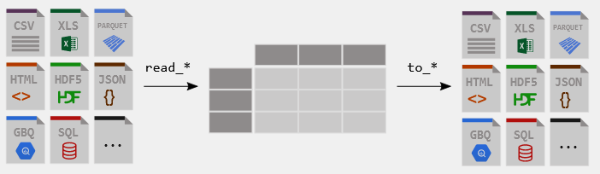
Read and Write
https://pandas.pydata.org/docs/getting_started/index.html

Slide 30
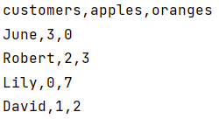
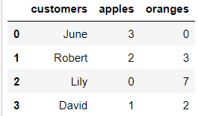
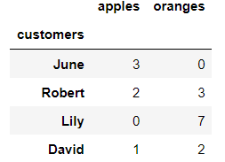
Reading data from CSVs
With CSV files all you need is a single line to load in the data:
CSVs don't have indexes like our DataFrames, so you need to designate the index_col when reading:
df = pd.read_csv('purchases.csv')
df = pd.read_csv('purchases.csv', index_col=0)

Slide 31
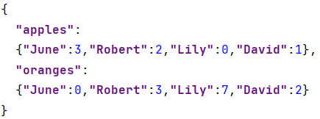
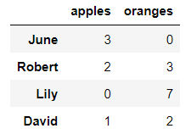
Reading data from JSON
If you have a JSON file pandas can read this just as easily.
Notice this time the index came correctly since JSON allows indexes to work through nesting.
JSON isn't a tabular format. When pandas cannot deduce the JSON structure, set the orient parameter. (https://www.roelpeters.be/pandas-read-json-orient)
df = pd.read_json('purchases.json')
Notes:
https://www.roelpeters.be/pandas-read-json-orient/

Slide 32
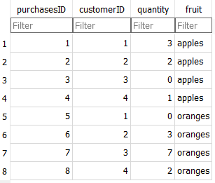
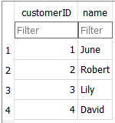
Reading data from databases
You can use any database, but we’ll be using SQLite
No installation required, the entire database is contained in a file that you can open using portable software
https://sqlitebrowser.org/
We’re using 2 tables and yes, they are badly normalized

Slide 33
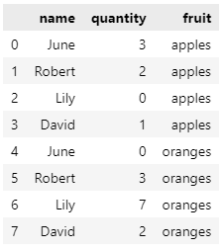
Reading data from databases
import sqlite3
con = sqlite3.connect("purchases.db")
df = pd.read_sql_query("SELECT c.name, p.quantity, p.fruit FROM customers c join purchases p on c.customerID = p.customerID", con)
df
The resulting dataframe is different from what we got from a CSV-file
That’s because of how normalized data works
We could fix this using the techniques that follow in this and the next chapter
But for now it’s a good enough proof of concept

Slide 34
Storing DataFrame in CSV, JSON or Excel
After extensive work on cleaning data in a DataFrame, the result can be saved as a file of your choice.
Similar to the ways we read in data, pandas provides intuitive commands to save it:
df.to_csv('new_purchases.csv')
df.to_json('new_purchases.json’)
df.to_excel('new_purchases.xlsx’)

Slide 35
Pandas – DataFrame basic operations

Slide 36
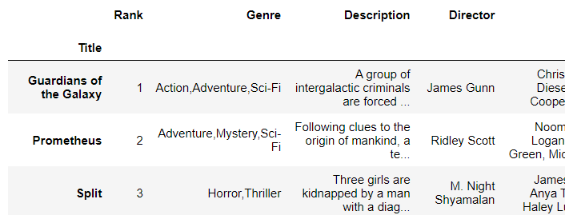
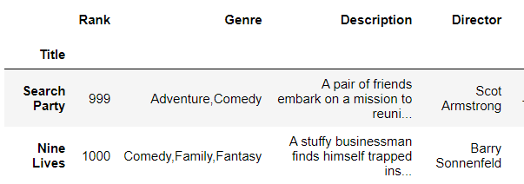
Basic DataFrame operations
Load the IMDB movies dataset from csv using the movie titles as index.
To get an overview of the first or last records in the DataFrame, use the head() or tail() methods. Both accept a number as argument to indicate how many records should be retrieved.
df_movies = pd.read_csv("IMDB-Movie-Data.csv", index_col="Title")
df_movies.head(3)
df_movies.tail(2)

Slide 37
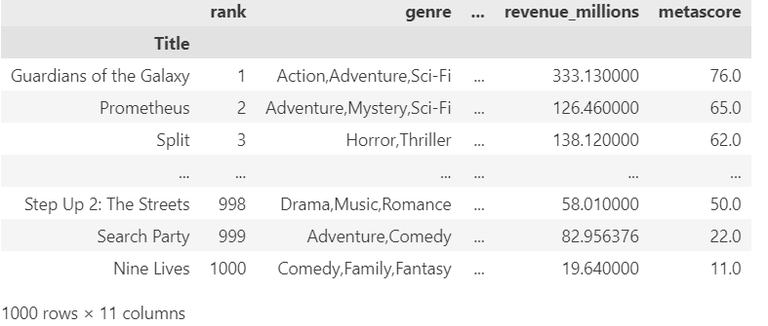
set_option("display.max_...")
To customize the number of rows or columns to be displayed:
pd.set_option('display.max_columns', 4)
pd.set_option('display.max_rows', 6)
df_movies

Slide 38
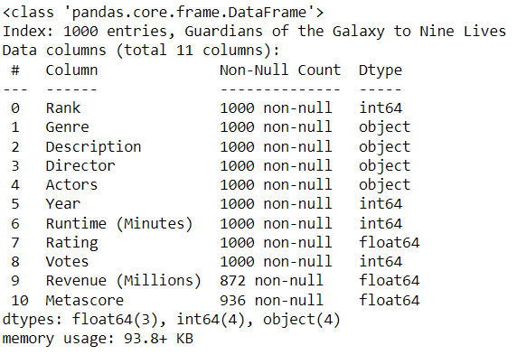
Getting info about the data
The method .info() provides the essential details about the dataset, such as the number of rows and columns, the number of non-null values, what type of data is in each column, and how much memory the DataFrame is using.
df_movies.info()
The dataframe counts 1000 rows and 11 columns This information can also be retrieved with the property shape.
df_movies.shape
Missing values!

Slide 39
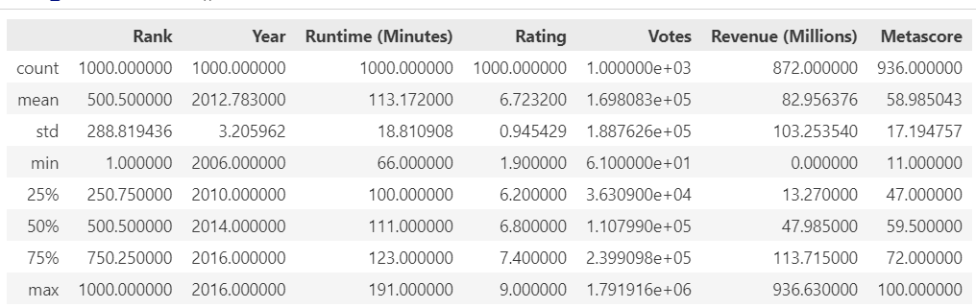
Getting info about the data
You can use the .describe() method to find basic statistical characteristics:
Count: number of non-missing values
Mean
Standard deviation
Median (0,50)
Quartiles (0,25/0,75)
Range: min-max
df_movies.describe()

Slide 40
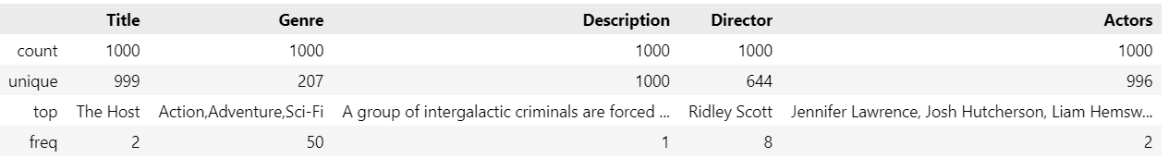
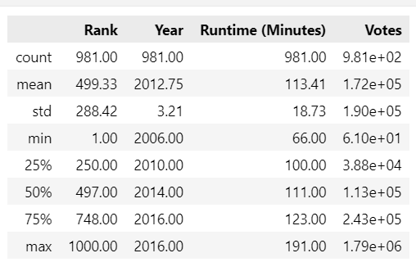
Getting info about the data
When using parameter “include” you can select columns of a certain type
df_movies.describe(include=“object")
df_movies.describe(include="int")
! Notice the characteristics change with the datatype
Notes:
exclude() is also possible

Slide 41


Column names cleanup
Best practice for column names is to lowercase them, remove special characters, and replace spaces with underscores
Here's how to get the column names of our dataset:
Use the .rename() method to rename certain or all columns via a dictionary.
df_movies.columns
df_movies.rename(columns={
'Runtime (Minutes)': 'Runtime',
'Revenue (Millions)': 'Revenue_millions'
}, inplace=True)
Inplace = true is an alternative way to code df_movies = df_movies.rename(….)

Slide 42

Column names cleanup
You can also set the columns property to a list of appropriate names:
The above solution is a long way to lowercase each column. Instead of just renaming each column manually we can do a list comprehension:
df_movies.columns = ['rank', 'genre', 'description', 'director', 'actors', 'year', 'runtime',
'rating', 'votes', 'revenue_millions', 'metascore']
df_movies.columns = [col.lower() for col in df_movies]

Slide 43
Pandas – Missing values

Slide 44
Missing values
When exploring data, you’ll most likely encounter missing or null values, which are essentially placeholders for non-existent values.
Most commonly you'll see Python's None or NumPy's np.nan
There are two options in dealing with nulls:
Get rid of rows or columns with nulls (amputation)
Replace nulls with non-null values (imputation)
Data scientists regularly face the dilemma of dropping or imputing null values. This decision requires profound knowledge of the data and its context. Overall, removing null data is only suggested if you have a small amount of missing data.

Slide 45
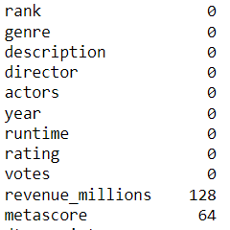
Missing values
.isnull() returns for every data cell whether a value is present.
To count the number of nulls in each column use an aggregate function for summing.
df_movies.isnull().sum()
We can see now that our data has 128 missing values for revenue_millions and 64 missing values for metascore.

Slide 46

Missing values: remove rows or columns
Remove rows with missing elements:
162 rows are deleted with missing revenue_millions and/or metascore
This obviously seems like a waste since there's perfectly good data in the other columns of those dropped rows
Other than just dropping rows, you can also drop columns with null values by setting the parameter axis=1:
Now the columns revenue_millions and metascore are gone
df_movies.dropna(inplace=True) df_movies. shape
df_movies.dropna(axis = 1, inplace=True) df_movies. shape
Notes:
Inplace bool, Whether to modify the DataFrame rather than creating a new one. → default False → create new

Slide 47
What's with this axis=1 parameter?
It's not immediately obvious where axis comes from and why is must be 1 to affect columns. To understand, just look at the .shape output:
This is a tuple that represents the shape of the DataFrame, i.e. 1000 rows and 11 columns. Note that the rows are at index 0 of this tuple and columns are at index 1.
Therefore axis=1 affects columns. This comes from NumPy and is a great example of why learning NumPy is worth your time.
df_movies.shape

Slide 48
Missing values: imputation
Imputation is a conventional technique used to keep valuable data that have null values.
There may be instances where dropping every row with a null value removes too big a chunk from your dataset, so instead we can impute that null with another value, usually the mean or the median of that column.

Slide 49
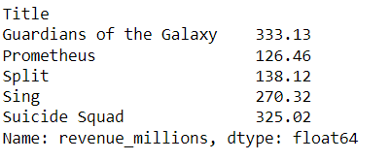
Missing values: imputation
Let's look at imputing the missing values in the revenue_millions column. First extract that column into its own variable:
revenue now contains a Series:
revenue = df_movies['revenue_millions']
revenue.head()

Slide 50

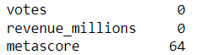
Missing values: imputation
Impute the missing values of revenue using the mean.
First calculate the mean value:
Next fill the nulls using .fillna() :
revenue_mean = revenue.mean()
revenue_mean
revenue.fillna(revenue_mean, inplace=True)
We have now replaced all nulls in revenue with the mean of the column.
Notice that by using inplace=True we have actually affected the original df_movies and not only the series.
df_movies.isnull().sum()

Slide 51
Pandas – Data manipulation techniques Conditional Selection Sorting Grouping Counting

Slide 52
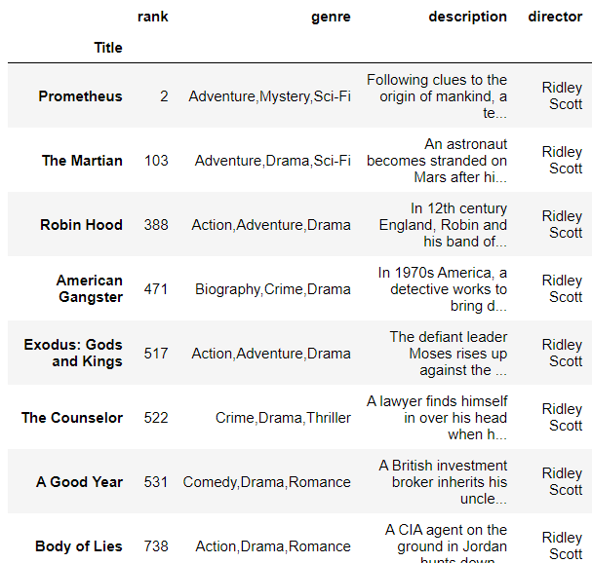
Conditional selections
We’ve gone over how to select columns and rows, but what if we want to make a conditional selection?
For example, what if we want to filter our movies DataFrame to show only films directed by Ridley Scott?
df_movies[df_movies['director'] == 'Ridley Scott']
This instruction can be read as SQL: Select df_movies where df_movies director equals Ridley Scott.

Slide 53
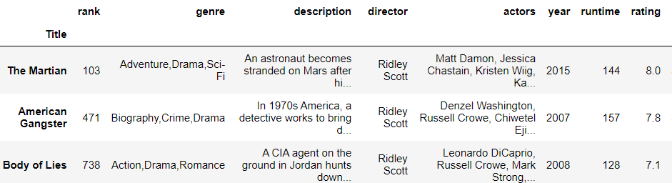
Conditional selections
Conditions can be combined by using logical operators:
| for "or"
& for "and“
Each condition is written between ()
E.g. movies directed by Ridley Scott with a rating above 7.0
df_movies[(df_movies['director'] == 'Ridley Scott') & (df_movies['rating'] > 7.0 ) ]

Slide 54
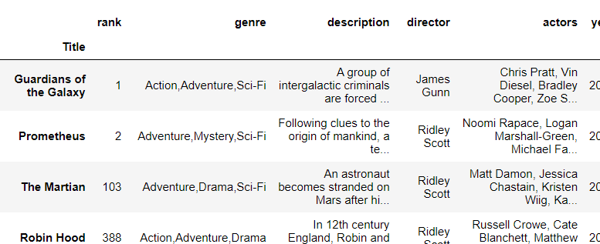
Conditional selections
Frequently used in selection making is the isin() method (~ OR)
E.g. movies directed by Ridley Scott OR James Gunn
df_movies[df_movies['director'].isin(['Ridley Scott','James Gunn'] )]

Slide 55
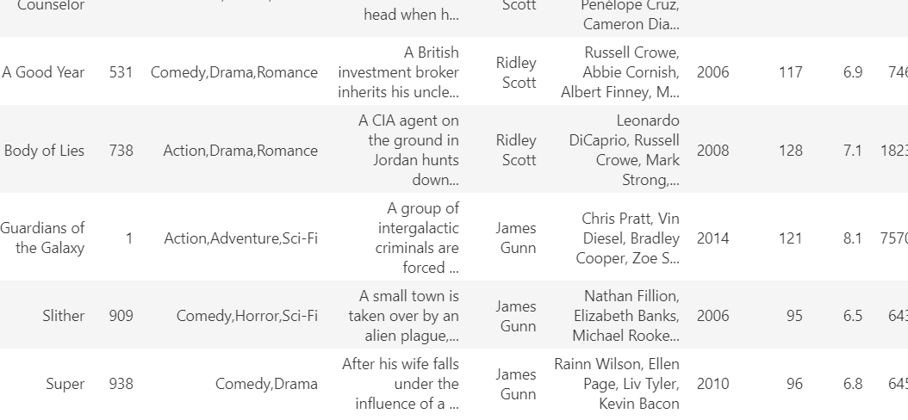
Sorting
In case you want to sort the movies by director, you can use the method sort_values()
df_movies[df_movies['director'].isin(['Ridley Scott','James Gunn'] )].sort_values(by='director',ascending=False)

Slide 56
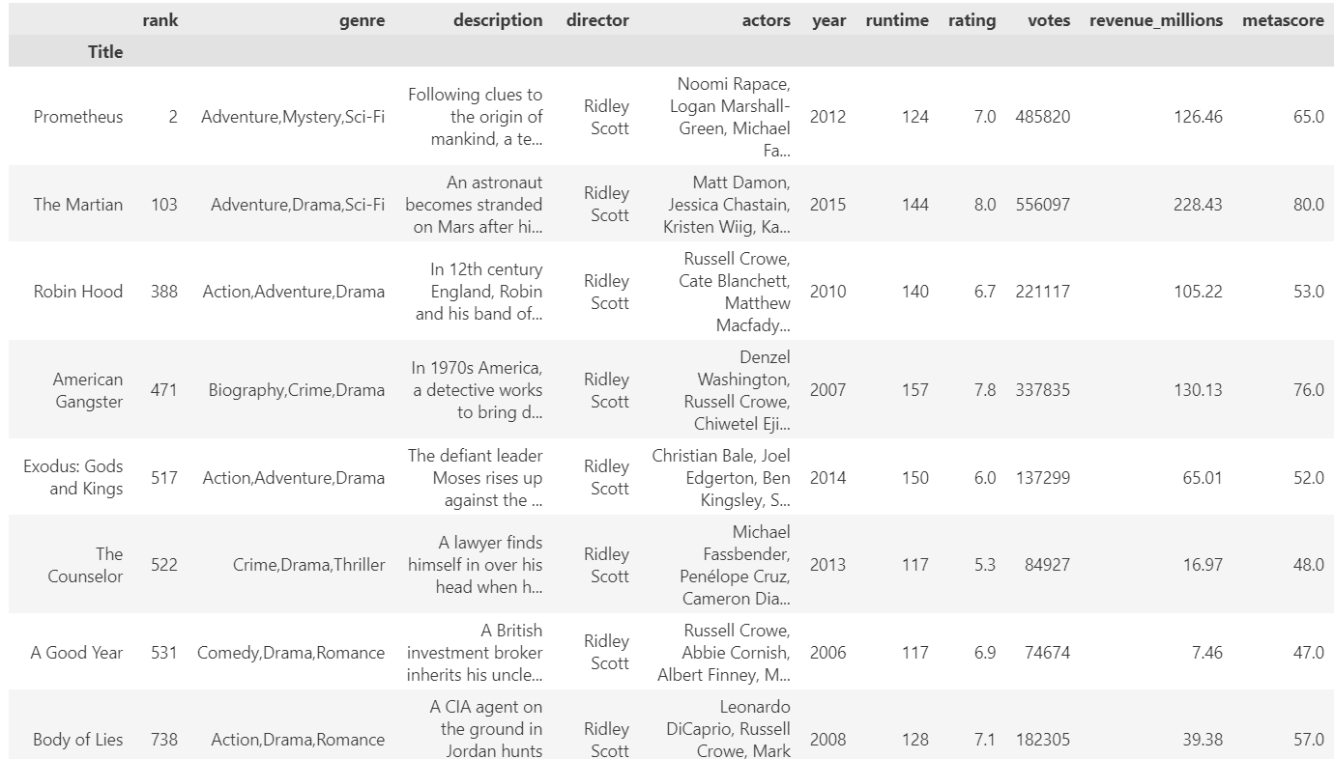
Grouping
The output “movies directed by Ridley Scot” can also be retrieved by using the methods groupby() and get_group()
grouped = df_movies.groupby('director')
grouped.get_group('Ridley Scott')

Slide 57

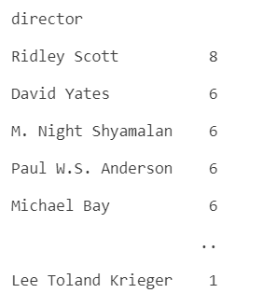
Counting
To retrieve the number of movies directed by Ridley Scot, just use the function len()
To retrieve the number of movies directed per director, use the method size()
grouped = df_movies.groupby('director')
len(grouped.get_group('Ridley Scott’))
df_movies.groupby('director').size().sort_values(ascending=False)

Slide 58
Counting
To count the number of movies directed by each director, you can immediately - without grouping - use the method value_counts()
df_movies['director’].value_counts()

Slide 59
Pandas – Cleaning a dataset using an example

Slide 60
Cleaning a dataset
Open the cars_cleaning notebook
Part 1 contains a detailed description of the opening and cleaning of some random dataset
We’ll go over the highlights in the following slides.

Slide 61
Create a calculated column
The cars dataset has mileage in miles per gallon, not in liters per 100 km
We can create a new column!
The formula is something you know (or lookup)
Note how we used a list comprehension
By going over a column we created a list of the same number of rows as the dataframe
This ensures the data is stored nicely

Slide 62
Categorical versus numerical variables
A categorical variable can have a finite number of values:
T-shirt sizes, places of embarkment for titanic, gender, …
There are 2 types of categorical variables
Ordinal (ordered) “S/M/L/XL/XXL”
Nominal (unordered) “Male/Female”
A numerical variable can have any quantitative value:
Height, weight, number of bikes you own, …
There are 2 types of numerical variables
Discrete (finite number of possible values) : number of bikes
Continuous (infinite number of decimal values) : height, weight

Slide 63
Categorical versus numerical variables
Let’s say “age” is in the database
Is a continuous numerical field if: You store the age as number with digits behind the comma (1,675; 3,54; 43,33453; …)
Is a discrete numerical field if: You store it as an age (1, 3, 43, …)
Is an ordered categorical field if: You can only have a limited number of ages, like kids in a kindergarten class (2, 3 or 4, but nothing else)
Is never an unordered categorical field.

Slide 64


Categorical variables
Why is this important?
If you have categorical data and you tell pandas, pandas will take it into account when creating graphs
How then?
Unordered:
Ordered:

Slide 65
Cars notebook
Part 2 of the notebook is about selections and aggregations.
Make sure you understand the basics well.

Slide 66


Exercises
Kaggle course Pandas: https://www.kaggle.com/learn/pandas
Make the exercises from lessons 1 - 2 - 4 – 5
Notebook Flights

Slide 67
Resources
https://www.learndatasci.com/tutorials/python-pandas-tutorial-complete-introduction-for-beginners/
https://pandas.pydata.org/Pandas_Cheat_Sheet.pdf

